Slide 1

Introduction to Artificial Intelligence – Final Project Demo

Slide 2
End-to-end Multi-class Dog breed classification
By,
Venkata Harish Gogineni,
Pavan Kumar Gonna,
Sohith RajGopal Chinnam.

Slide 3
Problem Description:
1. Problem:
Identifying the breed of a dog, given an image of a dog.
2. Data:
Kaggle's dog breed identification competition.
3. Evaluation:
The evaluation is a file with prediction probabilities for each dog breed of each test image.
4. Features:
Info about data:
Unstructured images Best to use deep learning/transfer learning.

Slide 4


DATA SET DESCRIPTION:
TRAIN DATA & TEST DATA SETS: Contains the dog images of different breeds
LABEL DATA SET: Contains different Dog breed names with respective ID

Slide 5

Data PrEPRocessing
we have taken huge dataset. So, It’s hard to process this large data in local servers. For this we have used Google Colab with high GPU.
Later the data is converted into Tensors using TensorFlow and TensorFlow_Libraries which is nothing but the numerical representation of the loaded data.
Preprocessing Images(turning imagesinto Tensors) Function that preprocess our images into Tensors: Take an image filepath as i/p.Use TensorFlow to read the file and save it to a variable, imageTurn our image (jpg) into Tensors. Resize the image to a shape of (224, 224).Return the modified image.

Slide 6

MODEL BUILDING WITH DATA SETS :
We used Keras, on the other hand, It is a high-level API that runs on top of TensorFlow. Keras simplifies the implementation of complex neural networks with its easy to use framework.
Using this, we divide our data into small batches with different number of dog images(32, 100, 1000 etc.;).
After these batches are used to train our model one after another to get the breed of a dog.

Slide 7

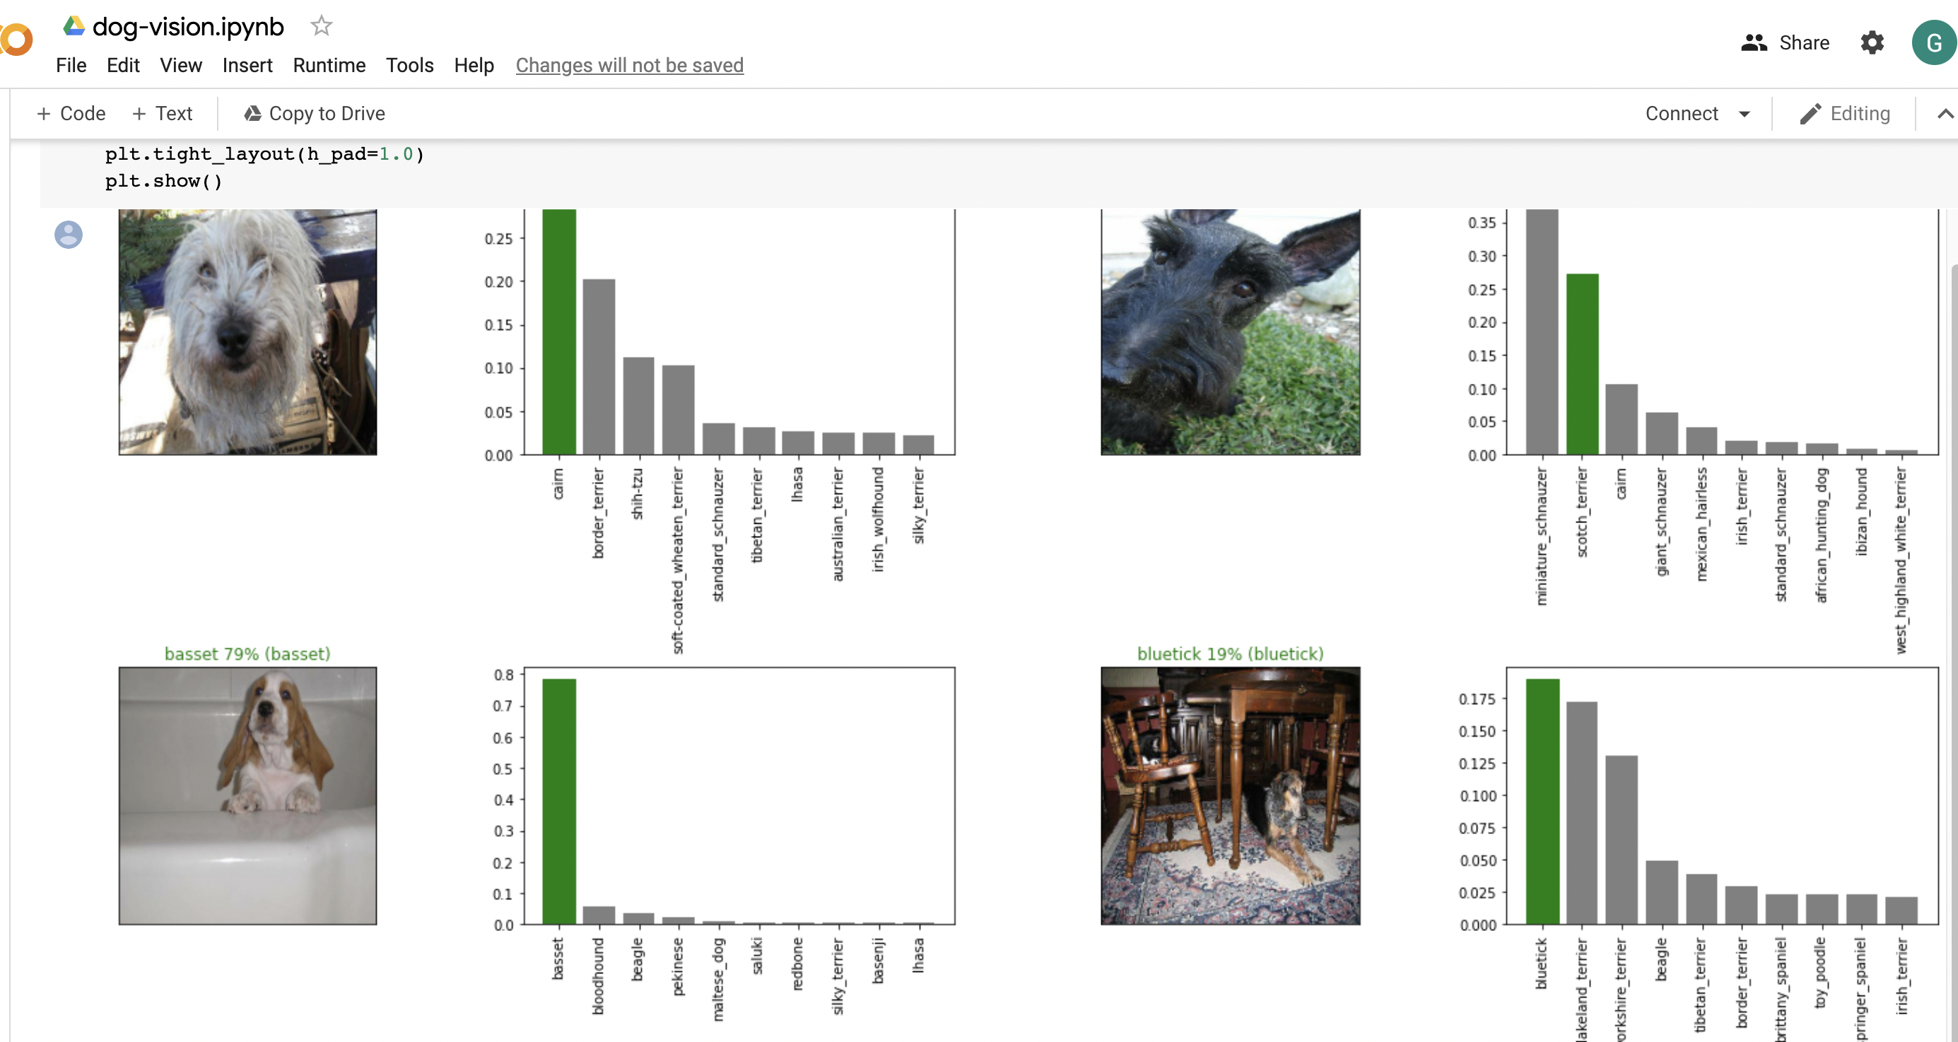
OBSERVATIONS OBTAINED AFTER BUILDING MODEL:
* Result shows us the probability of Dog breed prediction for the respective Dog images which are loaded into the model.

Slide 8

Thank you

